Slide 1
Microservices DESIGN
Classroom

Slide 2
A Microservice has a well-defined boundary
A Domain Driven Design aligns well with microservice design and has well defined integration points with other domains
A Bounded Context encapsulates a Domain
Domain Driven Design & Bounded Context
Notes:
Starting with a Monolithic app or starting from scratch, we need to identify candidates for our microservice architecture. One approach is Domain Driven Design.
There maybe functionality that is being provided which is distinct from other functional elements. The components that make up this piece of functionality work and talk together using common terminology. All activity that is being performed is typically self contained. This functional boundary is our domain.
All internal communication stays within that boundary context.
When data needs to be passed in or out of that boundary it goes though a well defined interface. This interface is seen as a contract with our consumers of this service, perhaps another microservice.
These consumers need to know that if they make a call for a particular action it will be honoured. If the functionality within the boundary is extended, perhaps by adding a new feature, this should not initially effect the consumer.
If the consumer originally called on V1.0 of our API and asked for a particular action to be honoured (Action-A: calling for a sequential Id of a customer) when the new feature-B is added (all customers now are identified via a GUID), calls for Action-A should still be honoured as well as providing Action-B(for feature-B) for updated consumers that support use of the GUID. Now V1.1 of the API
Semantic Versioning assists here as version 1.1 of our new API is still backwards with V1.0.
This could of course continues as we add support for new features and actions: C, D E etc (V1.2,V1.3,V1.4 respectively).
As we deprecate version 1 support and finally remove it, all legacy support is removed and only new features supported we can move to v2.x

Slide 3
Domain Driven Design
City
Industrial park
Notes:
An approach to software development is Domain Driven Design. It assists by placing the projects focus on the core domain and domain logic. It also assists in creating collaboration and understanding using ubiquitous language between technical and domain experts. The problems that a particular domain faces can then be iteratively addressed and refined with all SME and stakeholders.
If following on from the previous topic, as long a any contracts of communication are honoured, focus can be maintained on improving the domain without consideration or affect/effect to/from others. Refactoring for example.
“Ubiquitous Language is the term Eric Evans uses in Domain Driven Design for the practice of building up a common, rigorous language between developers and users.
Evans makes clear that using the ubiquitous language in conversations with domain experts is an important part of testing it, and hence the domain model. He also stresses that the language (and model) should evolve as the team's understanding of the domain grows.
DDD is about designing software based on models of the underlying domain. A model acts as a Ubiquitous Language to help communication between software developers and domain experts. It also acts as the conceptual foundation for the design of the software itself - how it's broken down into objects or functions. To be effective, a model needs to be unified - that is, to be internally consistent so that there are no contradictions within it.”
Using the example above, identifying the domain boundary can be difficult.
What is the goal we are trying to achieve?
Where is the natural boundary between one domain and another – maybe one business unit and another
What are the communication paths that our components follow – maybe a series of components work together and only pass output to another set
What ubiquitous language is being used
------------
In a simplified example if we were defining the functionality, standards, communication, levels of interactions, ‘language’ and the terms used to describe it where would our boundary be? Where could we separate the Business Logic & Requirements?
If we wished to set boundaries for international trade, maybe the world would be our domain of influence. Globalisation would allow this, but would the monolithic approach remove the flexibility we need or would this unified approach be more beneficial (Monolith isn’t always bad)
Perhaps we would prefer to trade with specific countries or sets of countries. Perhaps the interactions we have are distinct within the EU or as a set of trading partners with similar functions. This would be our domain? (no politics in the classroom please!!)
How far should we go if we’re splitting the monolith? Can we go too far?
Perhaps the member states of the UK should set their own rules, their own language of law, define the functionality and business process. Should control of these functions, standards, and inspection be passed down to the town level instead?
Trade may be commercial or retail and trading operations that are retail separated from commercial. Maybe the terms in which we operate, the processes we develop, can and should be broken down into Residential, Retail and Industrial?
Where is there a natural boundary for the functionality we wish to provide and the components that service it?
Going further, smaller, staying within the terms set by the higher level standards and business logic doesn’t mean that if there is a smaller domain, where its bounded context gives it isolation from other domains (apart from the interfaces we maintain), it cannot operate with its own terms in the most efficient manner.
This could be the factory in the industrial park (in the diagram on the slide).This could be the candidate to develop its own working practices, develop its own processes to provide the most efficient internals to working. As long as its interface is well maintained and everyone knows the rules of the interface, for example the highway code for the road in/out of its premise, then inside the factory boundary it can operate in anyway it sees fit. Refactoring itself to be the most efficient factory possible.
We could take this idea even down to the Warehouse, Factory block and Admin block. But would this be too granular and maybe decrease efficiency as those three units work and collaborate well as a unit?

Slide 4
Bounded Context
Quite often, the human factor is the dominant factor that draws boundaries between context – Business Domains
They may have unrelated concepts (the support tickets)
They may be shared concepts (customers and products)
Interfaces must be maintained between these customers and products
See note on API Contract and Semantic Versioning
Sales Context
Support Context
Opportunity
Customer
Customer
Pipeline
Territory
Ticket
Product
Product
Defect
Sales Person
Product Version
https://www.martinfowler.com/bliki/BoundedContext.html
Notes:
Bounded context is a main part of DDD.
DDD helps to deal with large models by helping to break them into separate boundaries (bounded contexts) and explicitly define the interrelationships.
The details of a single domain are encapsulated within a single bounded context : domain model, application services and integration points other bounded contexts/domains. This fits well with the autonomous microservice with well defined interfaces services a business capability.

Slide 5
Domain Driven Design & Bounded Context
Interface is a well-defined contract between domains
Integration points between your domains, the API, is a contract that is maintained
Changes internally should not break the ‘contract’ with other domains
Follow Semantic versioning to unambiguously define a contract
V1 > V1.1 etc backwards compatible API
V1> V2 etc no backwards compatibility maintained
Notes:
Starting with a Monolithic app or starting from scratch, we need to identify candidates for our microservice architecture. One approach is Domain Driven Design.
There maybe functionality that is being provided which is distinct from other functional elements. The components that make up this piece of functionality work and talk together using common terminology. All activity that is being performed is typically self contained. This functional boundary is our domain.
All internal communication stays within that boundary context.
When data needs to be passed in or out of that boundary it goes though a well defined interface. This interface is seen as a contract with our consumers of this service, perhaps another microservice.
These consumers need to know that if they make a call for a particular action it will be honoured. If the functionality within the boundary is extended, perhaps by adding a new feature, this should not initially effect the consumer.
If the consumer originally called on V1.0 of our API and asked for a particular action to be honoured (Action-A: calling for a sequential Id of a customer) when the new feature-B is added (all customers now are identified via a GUID), calls for Action-A should still be honoured as well as providing Action-B(for feature-B) for updated consumers that support use of the GUID. Now V1.1 of the API
Semantic Versioning assists here as version 1.1 of our new API is still backwards with V1.0.
This could of course continues as we add support for new features and actions: C, D E etc (V1.2,V1.3,V1.4 respectively).
As we deprecate version 1 support and finally remove it, all legacy support is removed and only new features supported we can move to v2.x

Slide 6
Microservice design summary
Focus on the Problem Domain
Ubiquitous Language
Bounded Contexts
Entities Value Objects: (Customer and Address) Aggregates
Repositories
Domain Events
Continuous Refinement
Order (Aggregate Root - Entity): Represents a customer's request
OrderLine (Entity): Specific product and quantity within an order.
Product (Entity): Is an entity the customer buys, referenced by OrderLine.
Customer (Entity): Customer information, such as name and address.
Address (Value Object)
Notes:
Focus on the Problem Domain:
Understanding the problem domain, specific area or business. Domain experts (non-technical stakeholders) and Developers must collaborate.
Ubiquitous Language:
Shared language between domain experts and developers when referring to concepts within the domain.
Bounded Contexts:
Define specific boundaries within which a particular model or language is valid. Different parts of a system might use the same term but with different meanings.
Entities and Value Objects: (Customer and Address)
Entities are objects with a distinct identity that runs through time, while value objects are objects that describe certain aspects of the system and are interchangeable.
Aggregates:
Clusters of related entities and value objects. They have a defined boundary and a root entity that acts as the access point to the rest of the aggregate. This concept helps in managing consistency and ensuring that changes to the system are made in a controlled manner.
Order (Aggregate Root - Entity): Represents a customer's request to purchase one or more products.
OrderLine (Entity): Specific product and quantity within an order. It is part of the order aggregate.
Product (Entity): Is an entity the customer buys, referenced by OrderLine.
Customer (Entity): Places orders. Customer information, such as name and address, is part of the aggregate.
Address (Value Object)
Repositories:
Repositories in DDD are responsible for accessing and persisting aggregates. Abstract the storage details and allow the application to work with aggregates in a way that is independent of the underlying DB.
Domain Events:
Changes or occurrences within the domain. These events can be used to communicate between different parts of the system, allowing for a decoupled and reactive architecture.
Continuous Refinement:
As the team gains more insights and knowledge about the problem space.

Slide 7
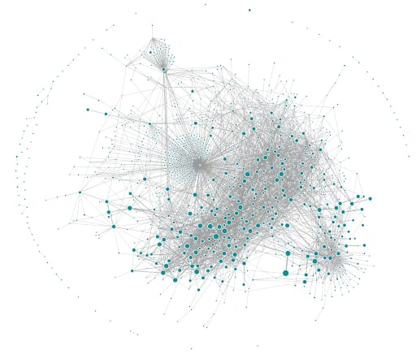
Challenges
Distributed system complexities
Increased operational overhead.
Proper planning, monitoring are essential.
Continuous improvement and feedback loops Refine and optimize the architecture over time.
Uber’s microservice architecture. https://www.uber.com/en-NL/blog/microservice-architecture/

Slide 8
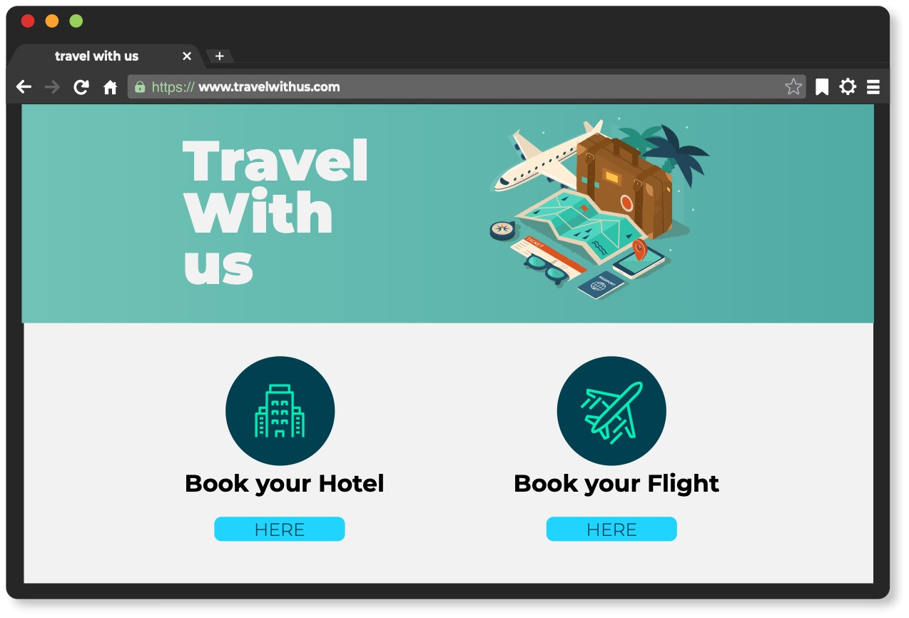
Notes:
Note: Our Travel Website – Monolith example on next slide.
When identifying the possible candidates for microservices, are there any natural divisions in functionality and bounded context?
For example, if we look at our travel app we can easily start to identify two separate services here: Flights and Hotels. As we go on our microservice journey there may be other candidates for microservices.

Slide 9



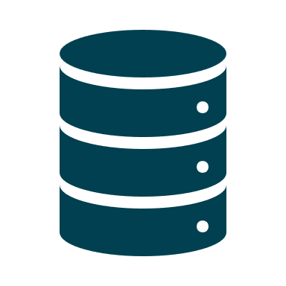
Authentication Module
User Experience and
Session Manager
Internet
Flight / Hotel / Trip
Services
(to search for and book flights, hotels etc.)
Data Access Services
User
Underlying framework
Monolithic Database
(many Tables)

Slide 10
Group Activity Breaking the Monolith
Split into small groups
Each group will look at the sample travel store Monolith in the previous slide and using the principals of Domain Driven Design & Bounded Context, will break it into Microservices.
Draw a diagram of your design
Present to the class the decisions made:
Include the challenges the business or developer will face as they break down the monolith
Make assumptions where appropriate but document and explain them
How granular should the Microservice be? Why?
How you may strangle the monolith as you go on the journey from Monolith to Microservice
Notes:
Guided by the tutor, split into a number of groups.
Using the example monolith diagram, following the principals of DDD and bounded context identify candidates for Microservices.
Diagram this on a flipchart together with background on the decisions made:
Include the challenges the business or developer will face as they break down the monolith
How granular should they be with the microservices and why
How they may strangle the monolith as they go on the journey from Monolith to Microservice
Approx.. 30 mins for group work and to prepare flipchart/ presentations
Approx. 30 mins for presenting to class

Slide 12
Product Catalogue Service:
Manages product information, including details like name, description, price, and images. This service can handle search functionality, categorization, and filtering.
Inventory Service:
Tracks the availability of products in the inventory. It can handle functions such as updating stock levels, managing product reservations, and notifying when stock is low.
Order Service:
Manages the order lifecycle, from order creation to fulfilment. It can include features like order validation, order tracking, and order history.
User Service:
Handles user authentication, authorization, and user profile management. This service ensures that users can securely log in, manage their accounts, and track their orders.
Payment Service:
Deals with payment processing, including payment gateway integration, handling transactions, and managing payment-related data.

Slide 13
Cart Service:
Shopping carts for users, add, update, and remove items.
Shipping Service:
Shipping carriers to calculate shipping costs, generate shipping labels, and tracking.
Review and Rating Service:
Product reviews and ratings. Feedback, trustworthy reputation.
Notification Service:
User notification, order confirmation, shipping updates, promotional messages.
Recommendation Service:
Product recommendations based on user behaviour, preferences, and purchase history.
Gateway Service:
Entry point for client requests, Routing to microservices also authentication and authorisation.

Slide 14
Monitoring and Logging:
Implement monitoring and logging within each microservice to track performance, errors, and overall system health.
Database per Microservice
Consider using database per microservice to maintain independence and data isolation.
Communication Between Microservices:
RESTful APIs, Message queues for inter-service communication. API gateways for external communication.
Containerization and Orchestration:
Like Docker, orchestrate them with tools like Kubernetes for deployment, scaling, and management.
Scalability: Independently scalable. Container orchestration to scale specific services based on demand.
Security: HTTPS, authentication and authorization, regular security audits.
Testing: Unit testing, integration testing, and end-to-end testing.

